Slide 1

Introduction Data Scientist
Bagus Fajar Apriyanto
Engineer
PT Bahasa Kinerja Utama (Bahasa Kita)

Slide 2
What is Data Science?
Data science is a multi-disciplinary field that uses scientific methods, processes, algorithms and systems to extract knowledge and insights from structured and unstructured data. -https://en.wikipedia.org/wiki/Data_science
Data science is the field of study that combines domain expertise, programming skills, and knowledge of math and statistics to extract meaningful insights from data. -https://www.datarobot.com/wiki/data-science/
Data science adalah suatu bidang studi yang mengkombinasikan kemampuan programming, matematika dan statistika, dan pengetahuan umum untuk mendapatkan suatu insight dari data terstruktur maupun unstruktur.

Slide 3
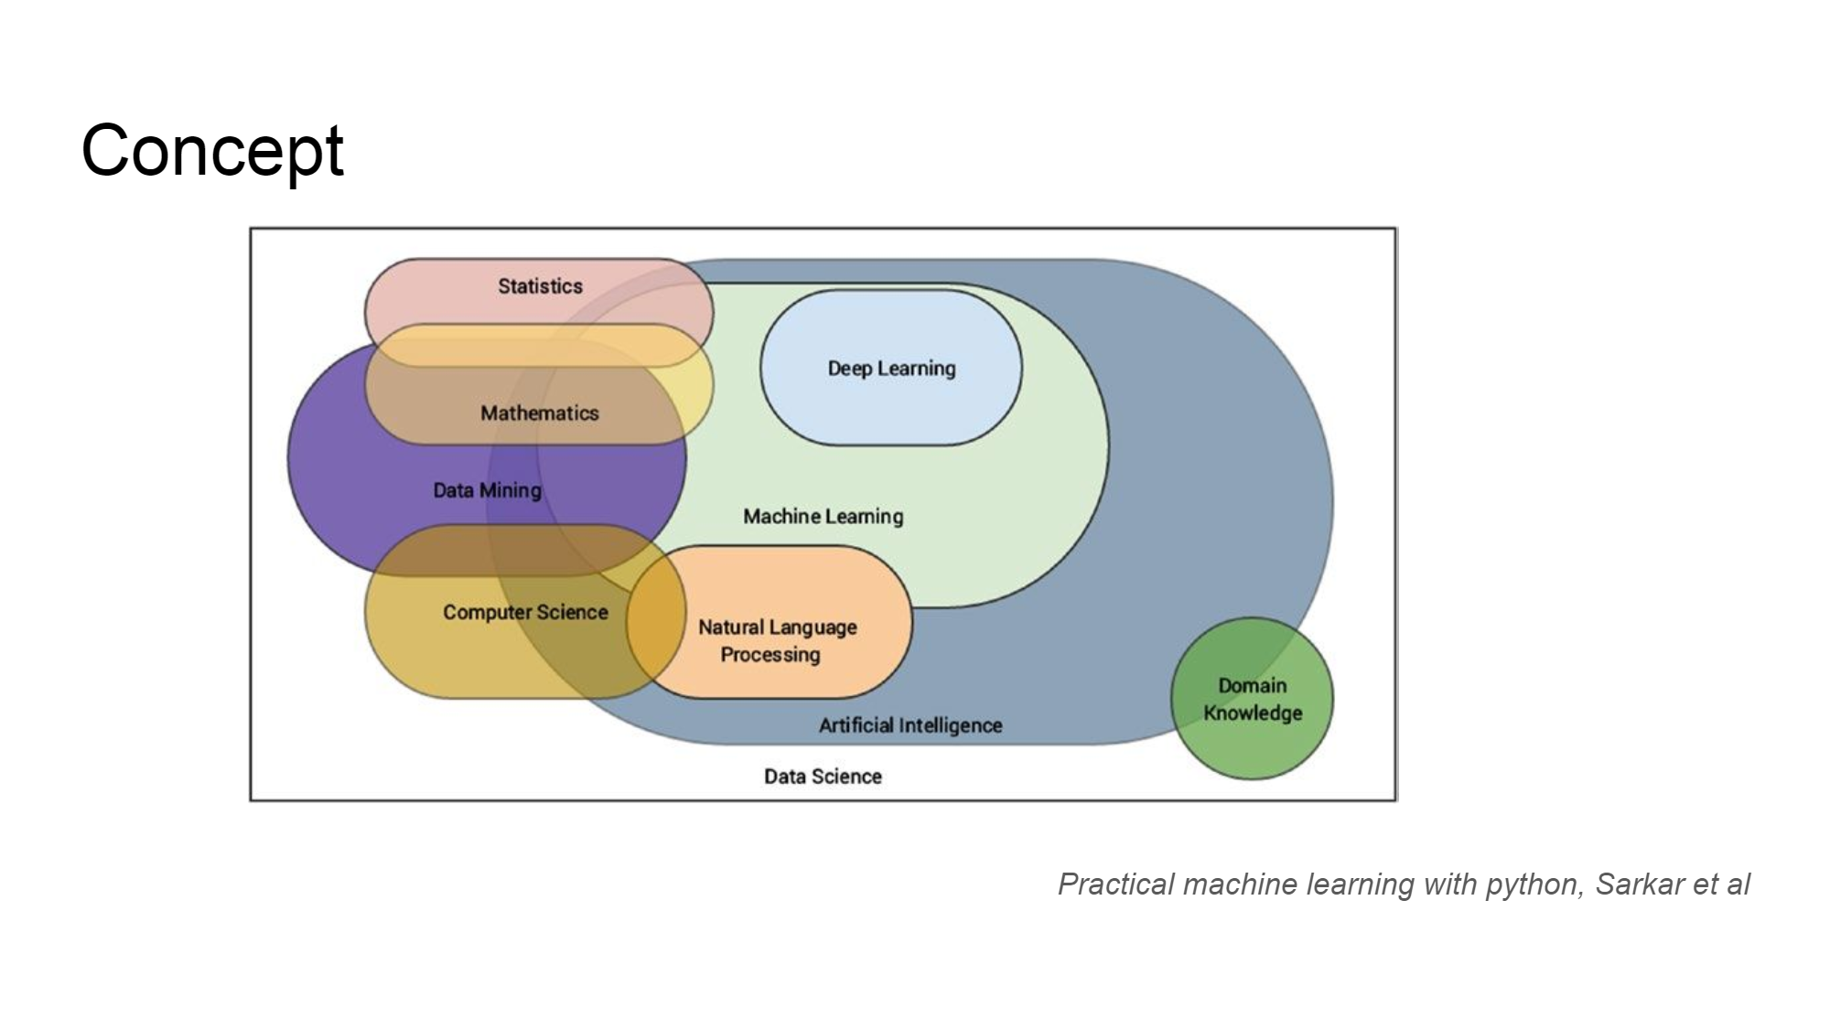

Slide 4
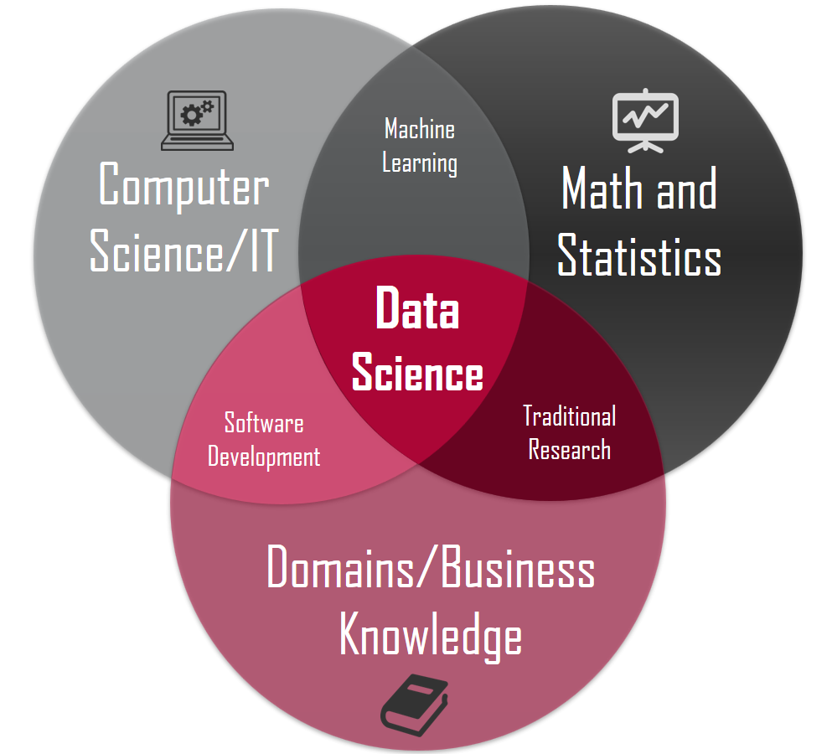
What’s you need?

Slide 5
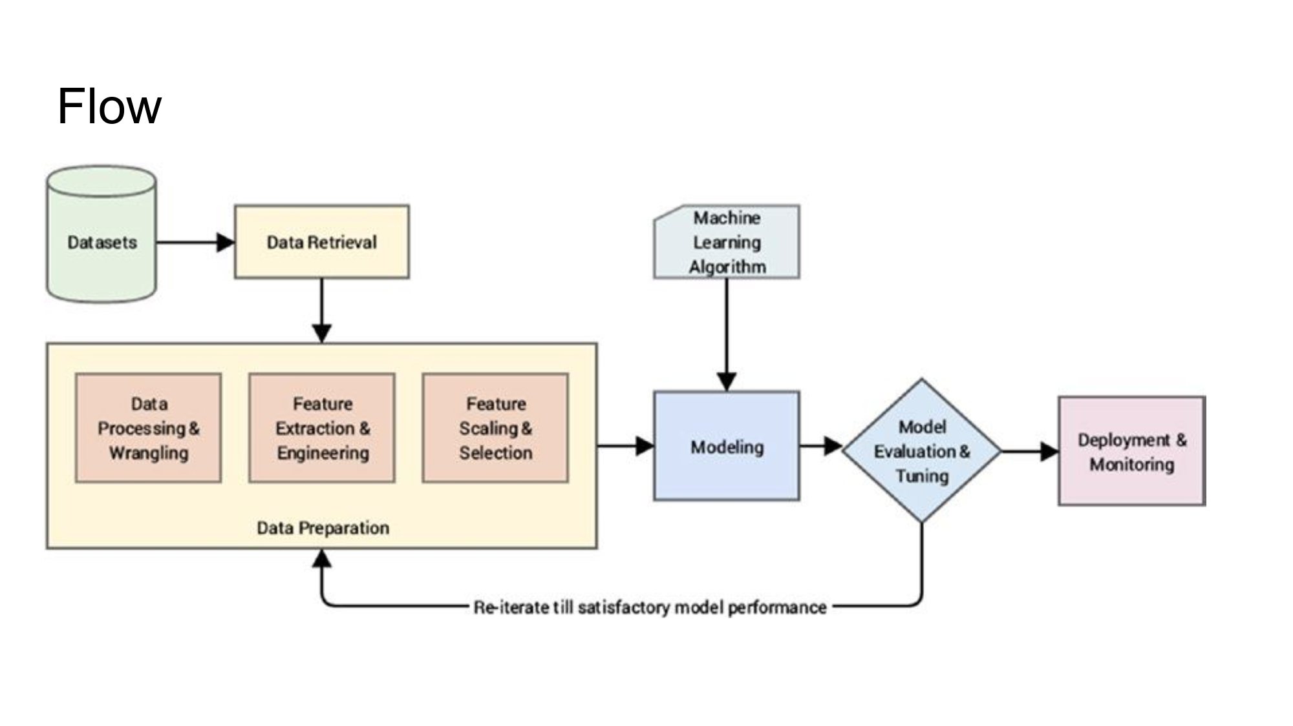

Slide 6
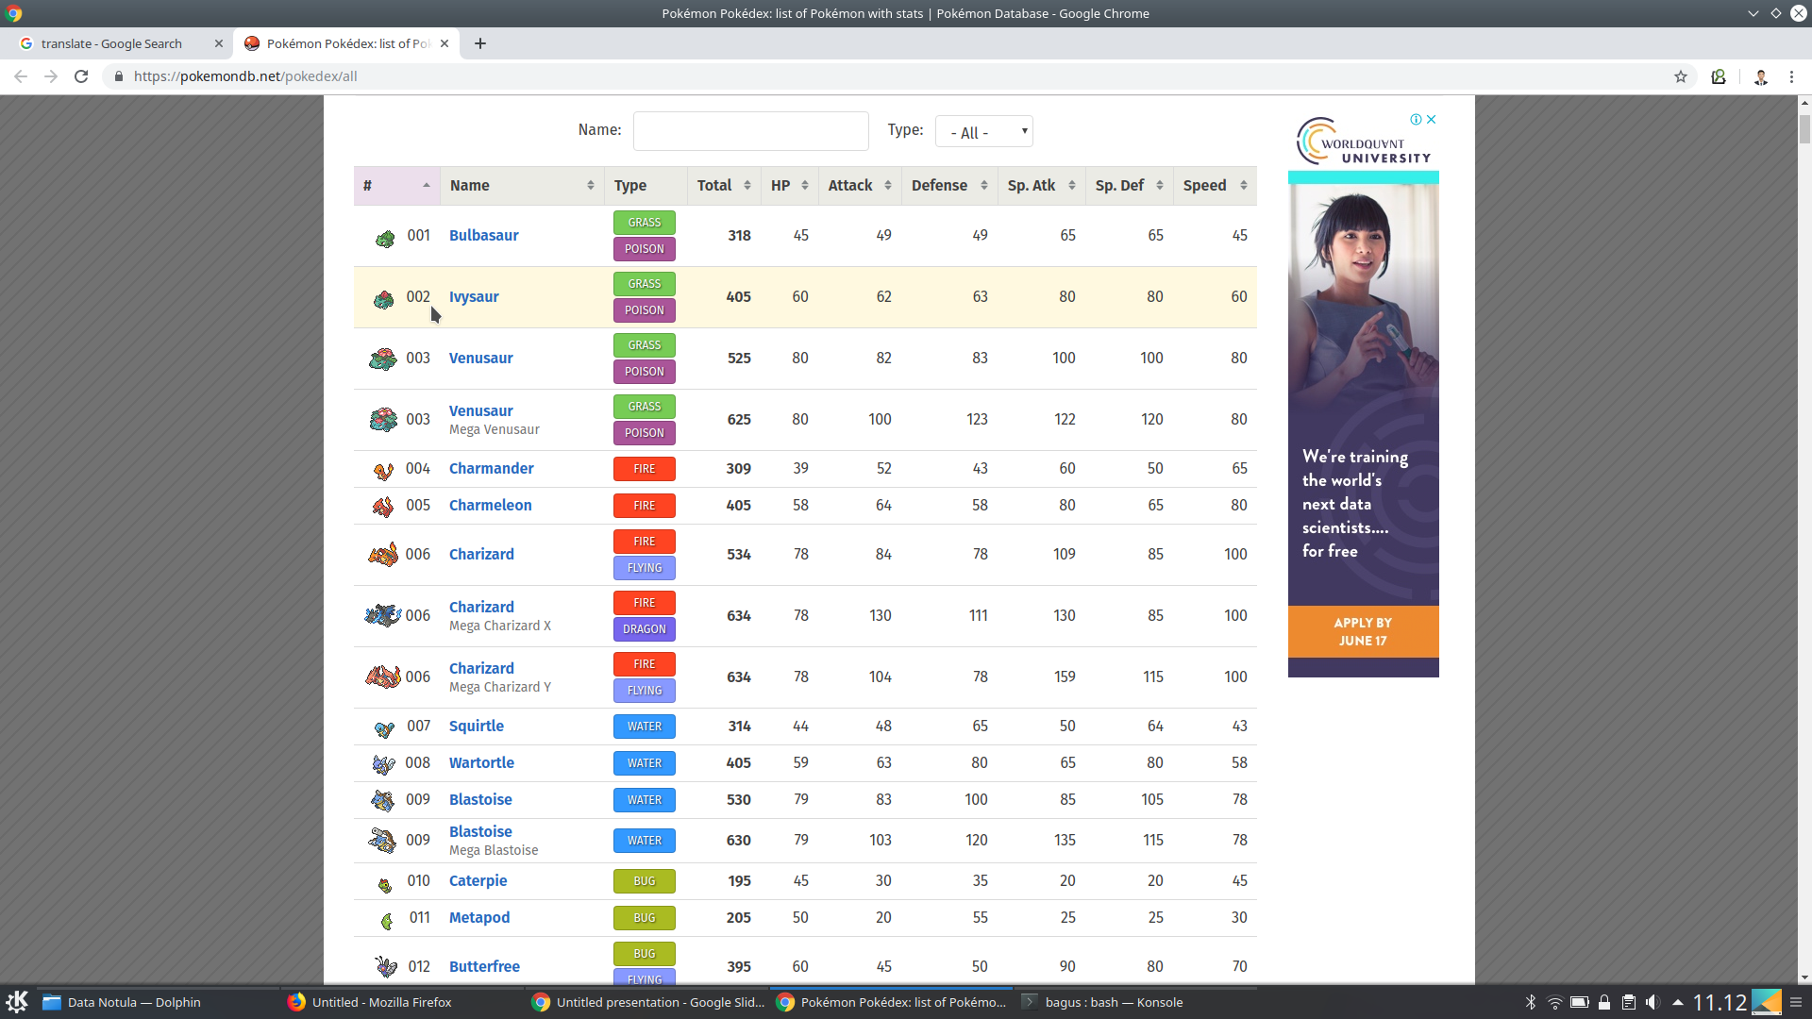
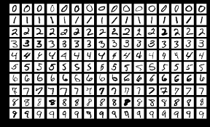
Dataset

Slide 7
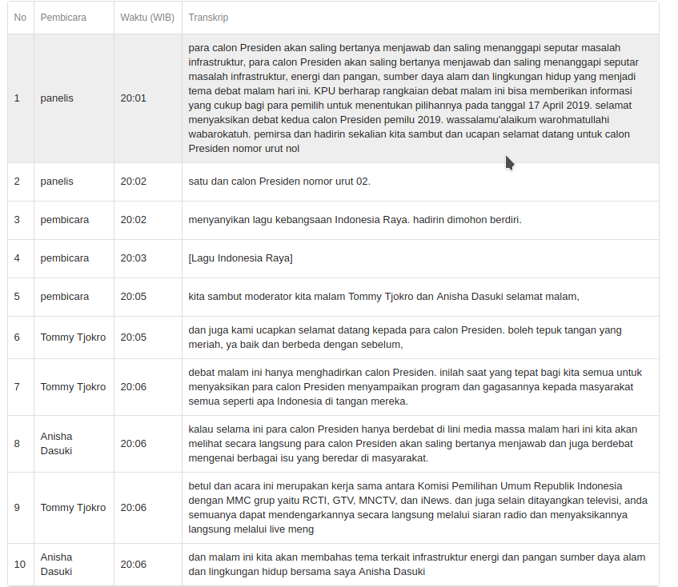
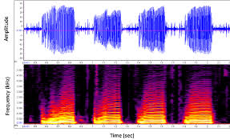
Dataset

Slide 8
Preprocessing
Missing Value: Drop or Fill with Mean, Median, Modus
Balancing Data: Oversampling and Undersampling
Outlier Detection
Regular Expression
Thresholding
Bluring
Fourier Transform
Etc

Slide 9
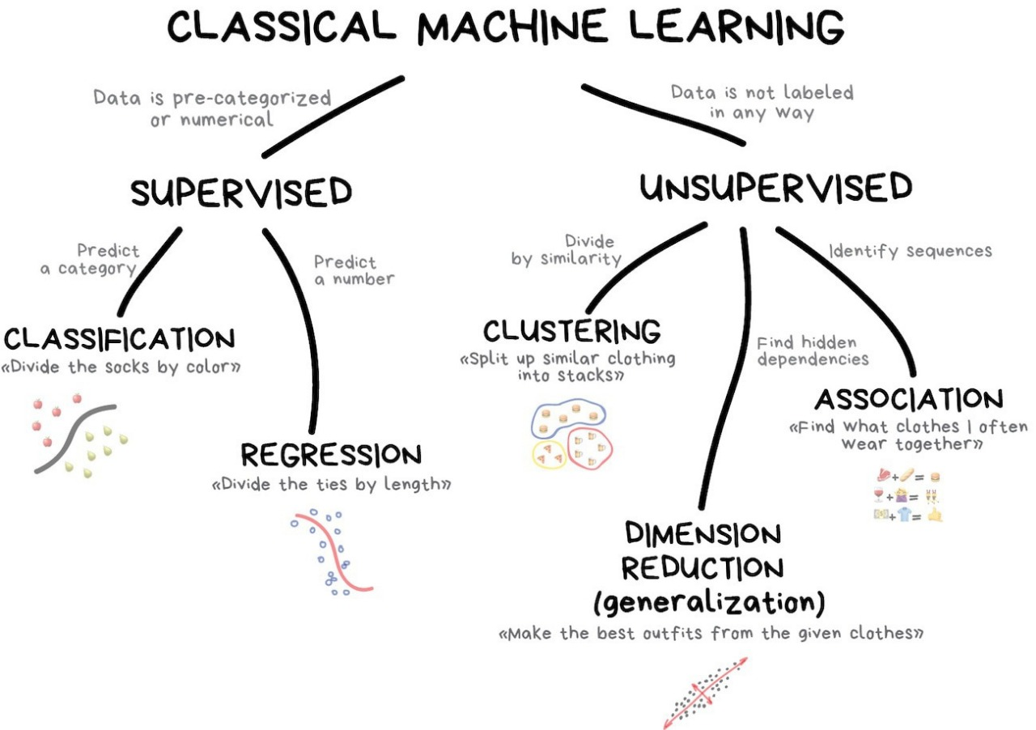
Modeling

Slide 10
Modeling
Machine Learning
Linear Regression
KNN
SVM
Naive Bayes
Decission Tree
Etc
Deep Learning
NN
CNN : Alexnet, Resnet, VGG16, etc
RNN
LSTM : Bidirectional LSTM, AWD LSTM, etc
Etc

Slide 11
Evaluation
Evaluate the model that has been made
Matrix Confusion
Precision
Recall
Accuracy
AUC
ROC
UAS (Unlabelled Attachment Score) - NER
LAS (Labelled Attachment Score) - NER
Etc

Slide 12
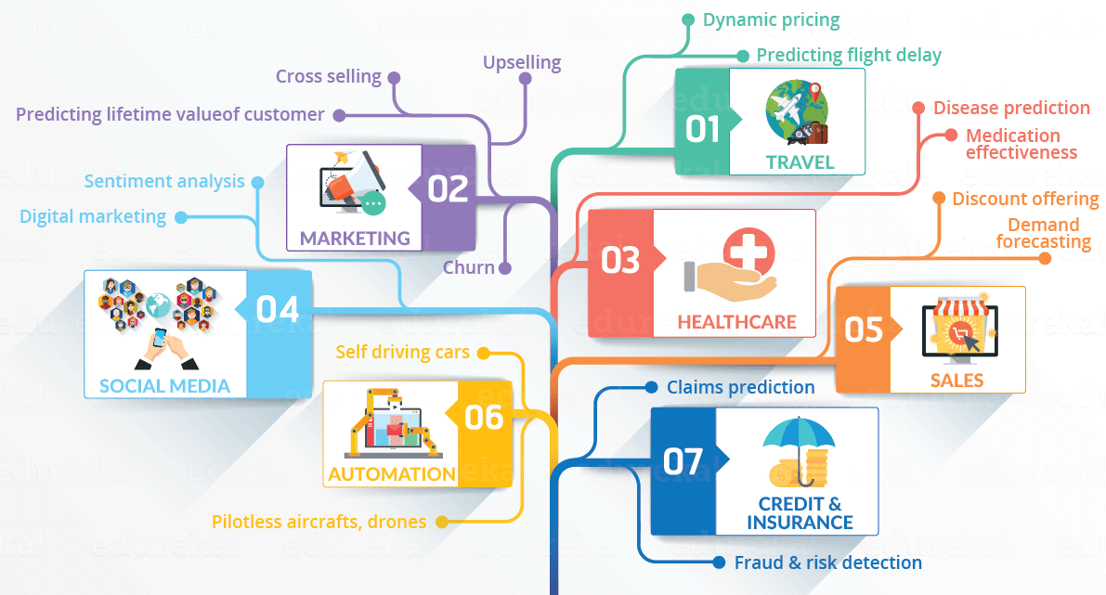
Application of Data Science
Source: https://www.edureka.co/blog/what-is-data-science/

Slide 13
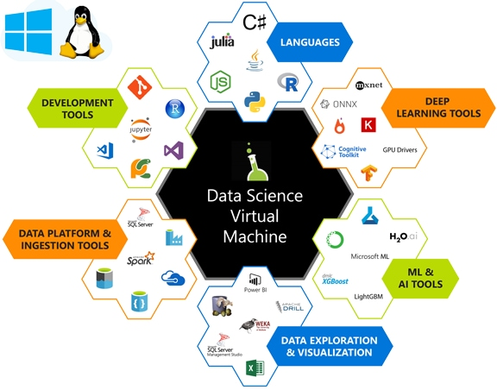
Tools
https://blog.revolutionanalytics.com/2019/01/rstudio-server-on-azure.html

Slide 14
Job
Business Analyst
Business Intellegence
Data Analyst
Data Engineer
Data Scientist
AI Engineer
AI Researcher
ML Engineer

Slide 15
Thank you

